Slide 1
Assortivity HIV Infection Status Example

Slide 2
Form Relationships Based On Physical HIV Infection Status
Goal: See how the impact of forming relationships based on the individuals infection status affects the spread of the disease.
Expect: Forming relationships with like status should reduce the spread of the disease.
No Interventions except Outbreak!!!
25% of population infected at outbreak.
Initial Population = 175,000
Overridden from Defaults
"Report_Relationship_Start" : 1,
"PFA_Cum_Prob_Selection_Threshold": 0.2,
"PFA_Update_Period_Transitory" : 30,
"PFA_Update_Period_Informal" : 30,
"PFA_Update_Period_Marital" : 30

Slide 3
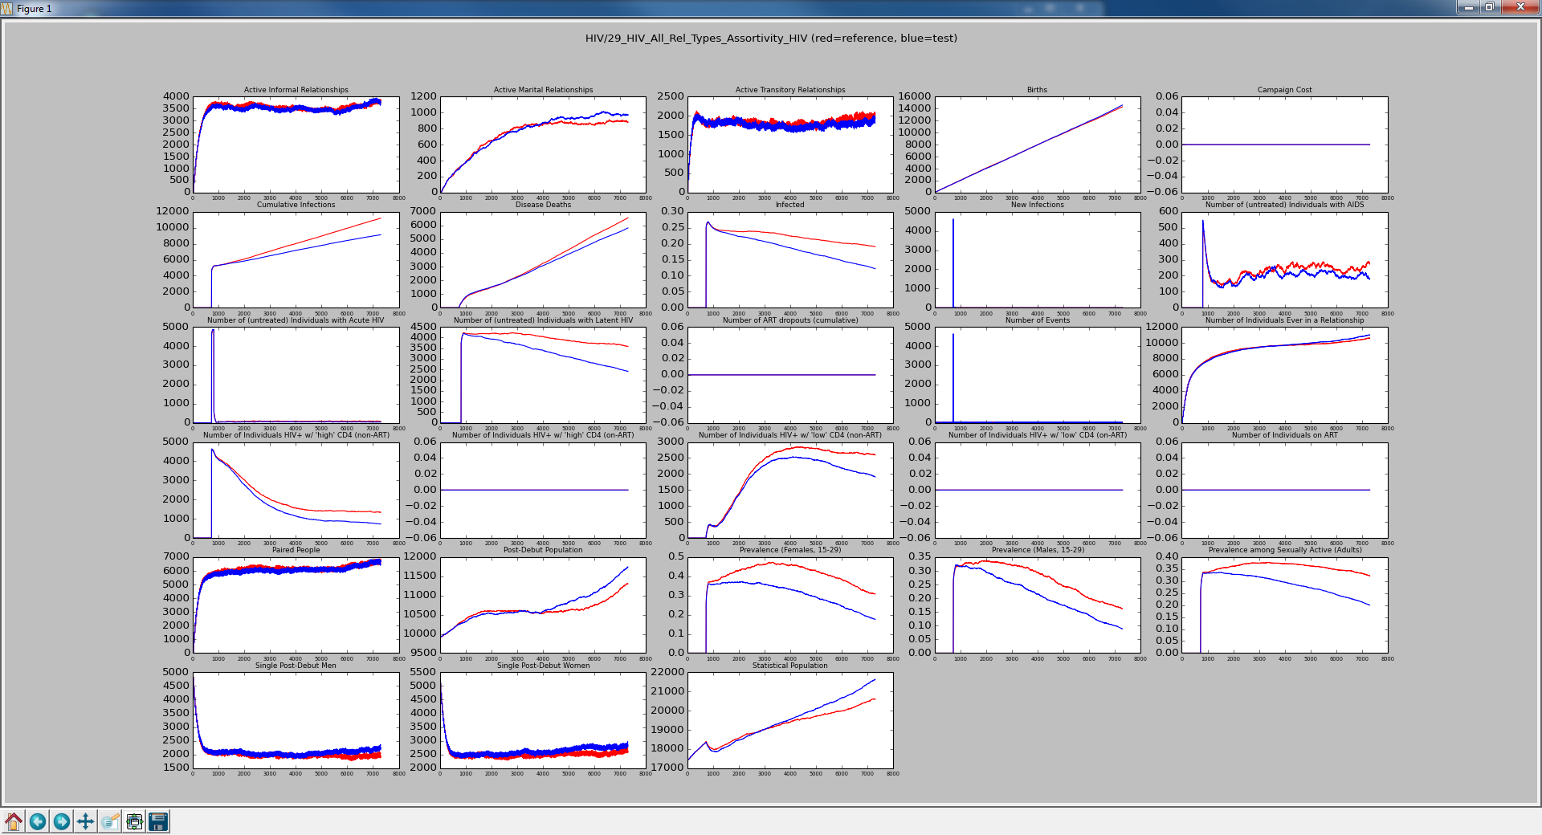
Red is All Types with No Groups Blue is All Types w/ Transitory with Matrix
[1.0, 0.0],
[0.0, 1.0]
Reduction in infections causes fewer deaths allowing more relationships.

Slide 4

Red is All Types with No Groups Blue is All Types w/ Transitory & Informal with Matrix
[1.0, 0.0],
[0.0, 1.0]
More discretion leads to saved lives.

Slide 5

Red is All Types with No Groups Blue is All Types with Matrix
[1.0, 0.0],
[0.0, 1.0]
All relationships are checking infection status. Getting maximum reduction in infection.

Slide 6
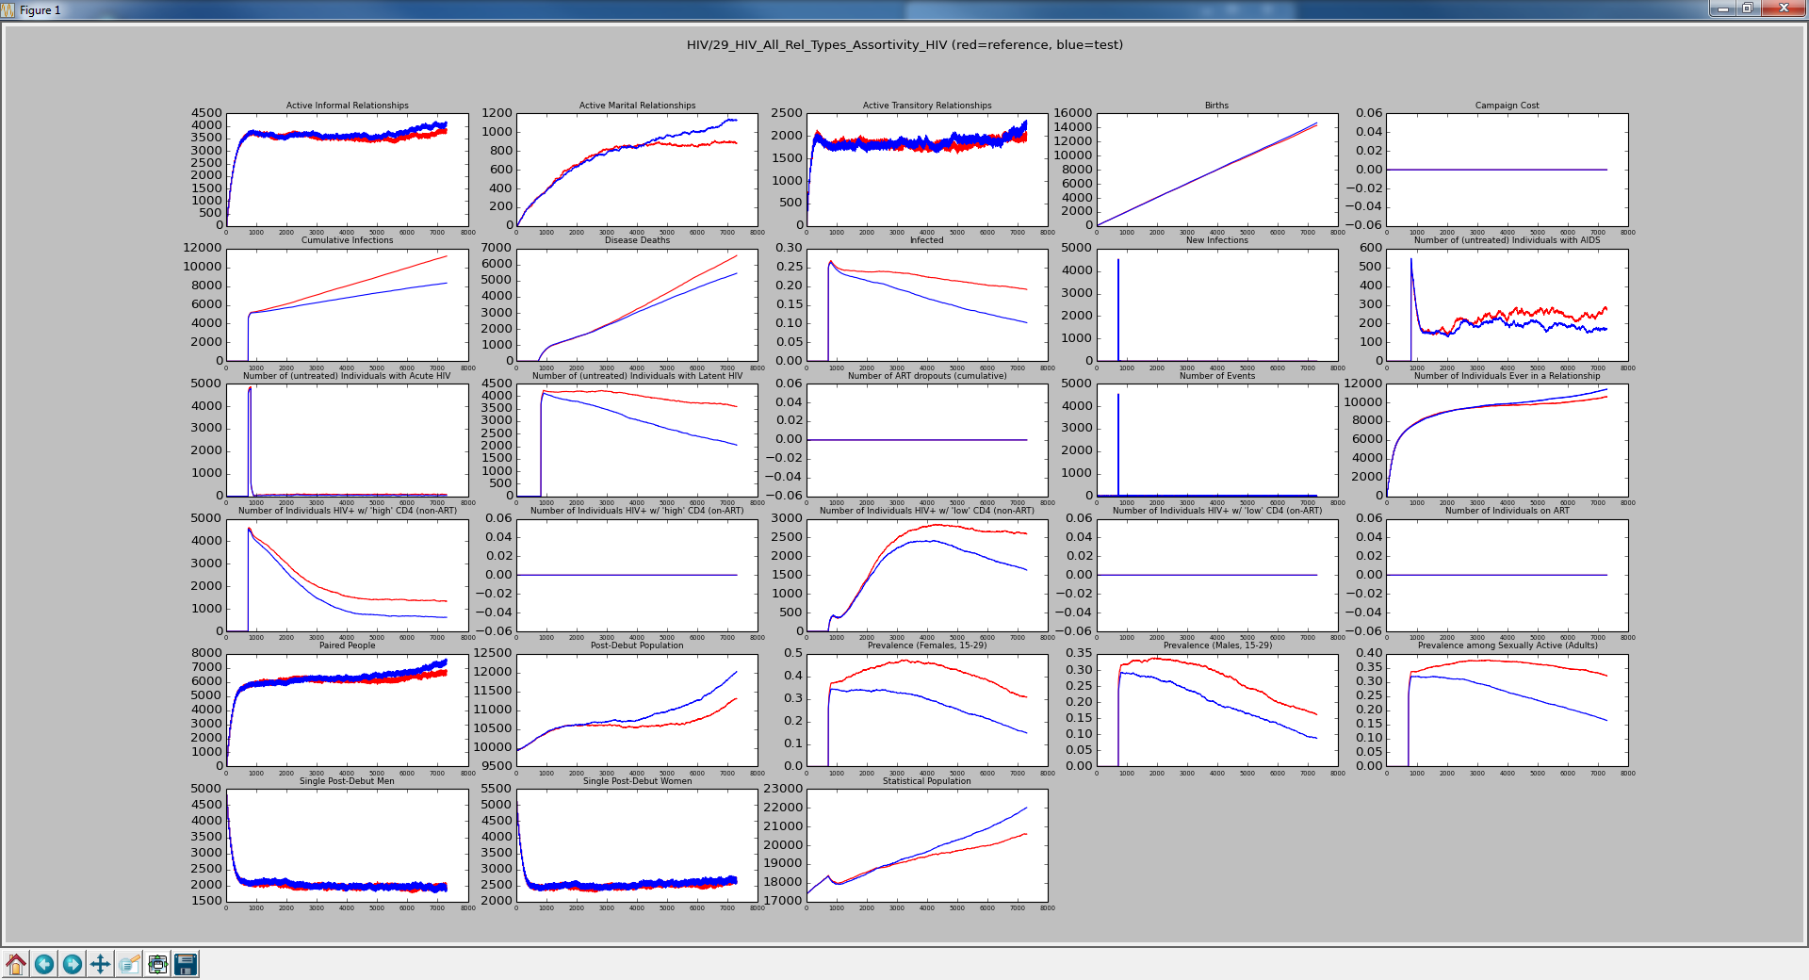
Red is All Types with No Groups Blue is All Types with Matrix
Allowing some relationships that are mixed increases the spread of the disease compared with zeros for the mixed infected status.
[0.9, 0.1],
[0.1, 0.9]

Slide 7
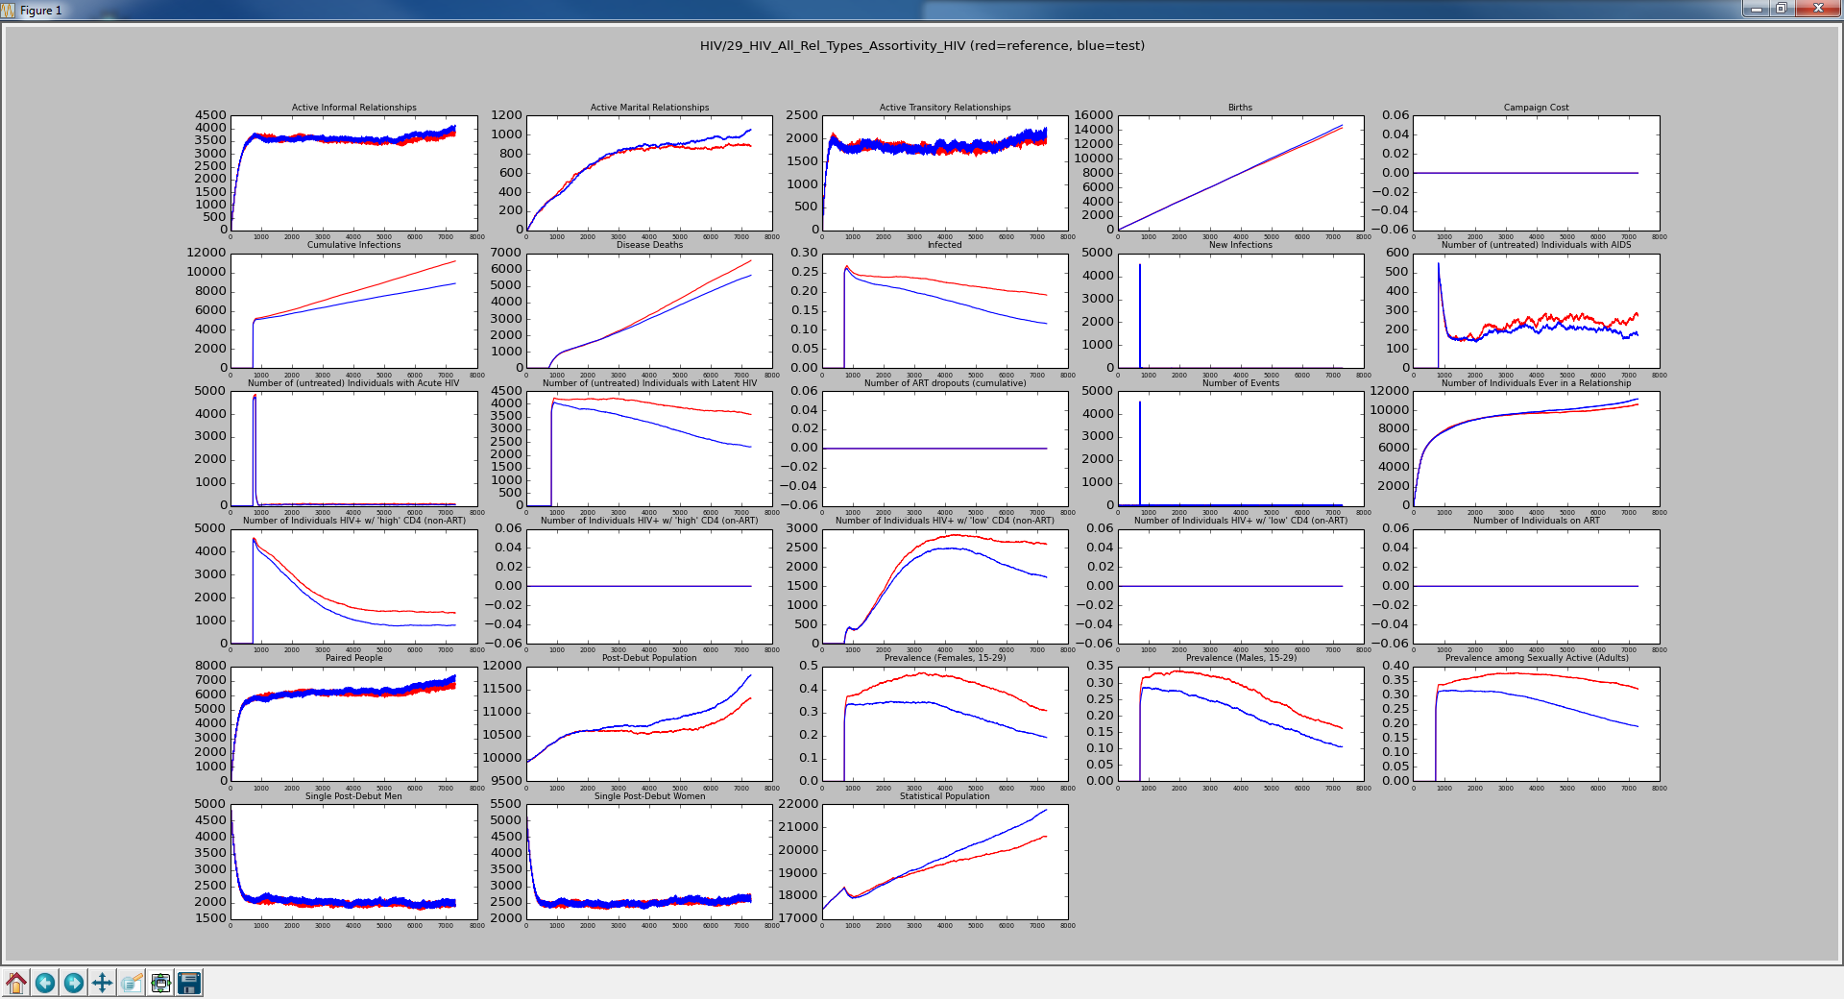
Red is All Types with No Groups Blue is All Types with Matrix
[0.8, 0.2],
[0.2, 0.8]
Increasing the mixed infection status relationships causes increased infection.

Slide 8
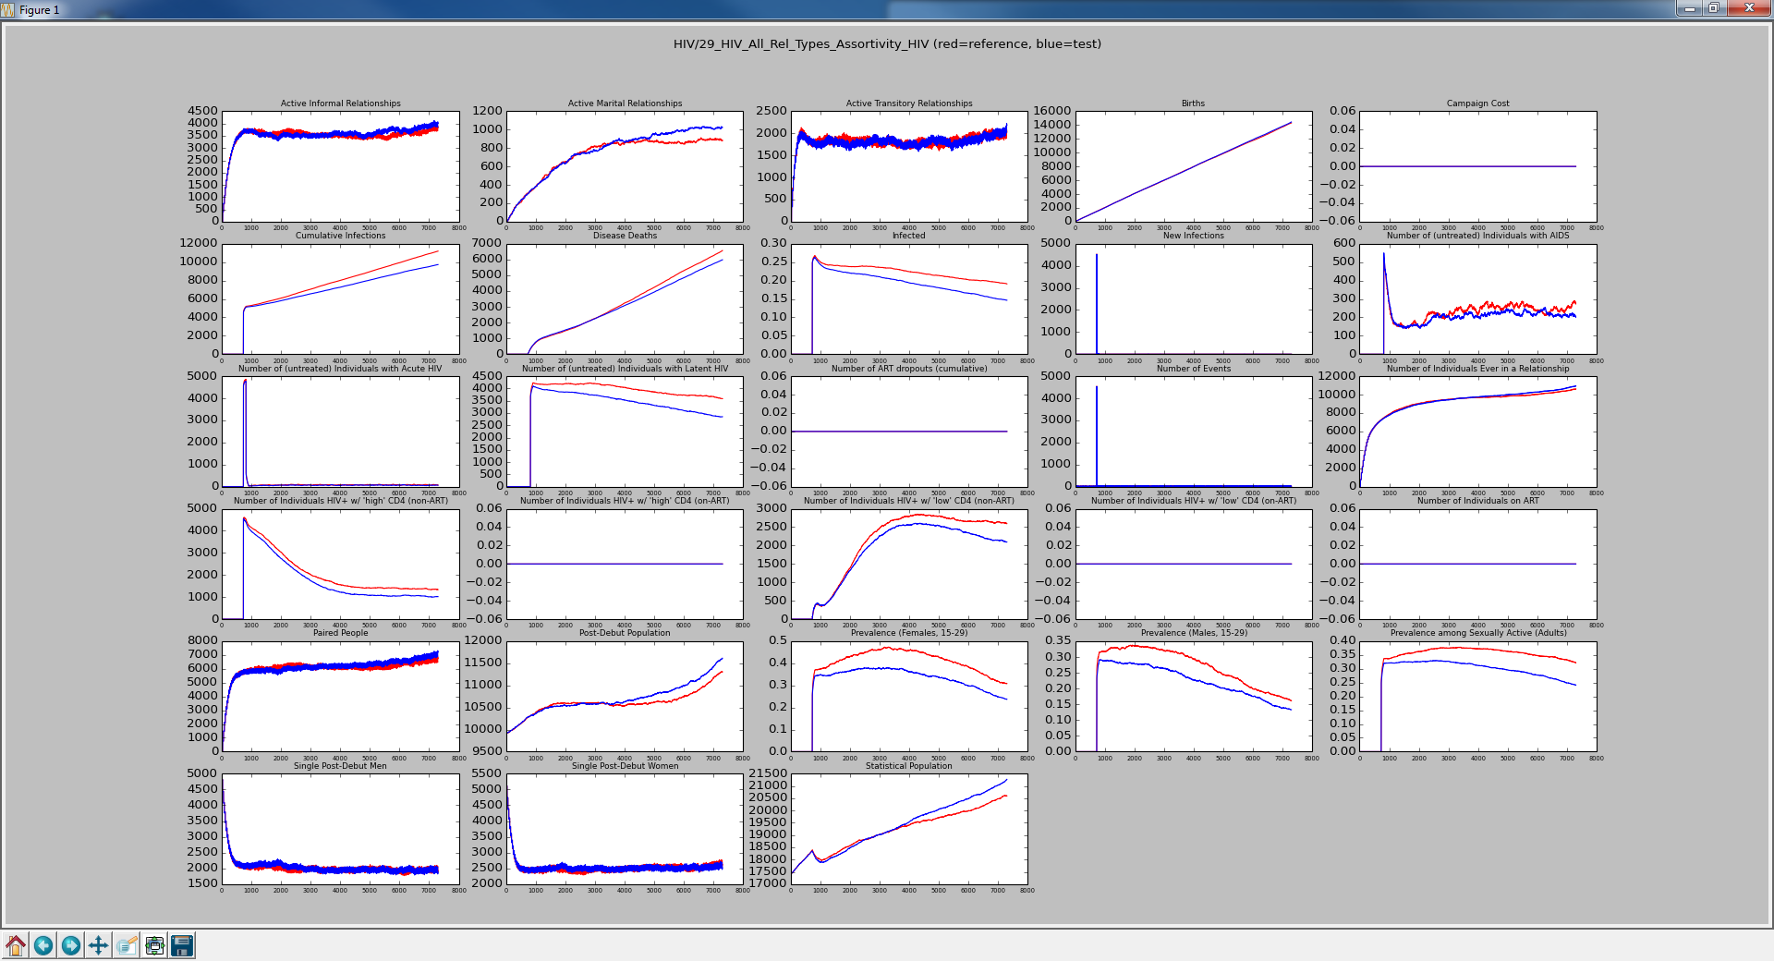
Red is All Types with No Groups Blue is All Types with Matrix
[0.7, 0.3],
[0.3, 0.7]
More mixed, more infection

Slide 9
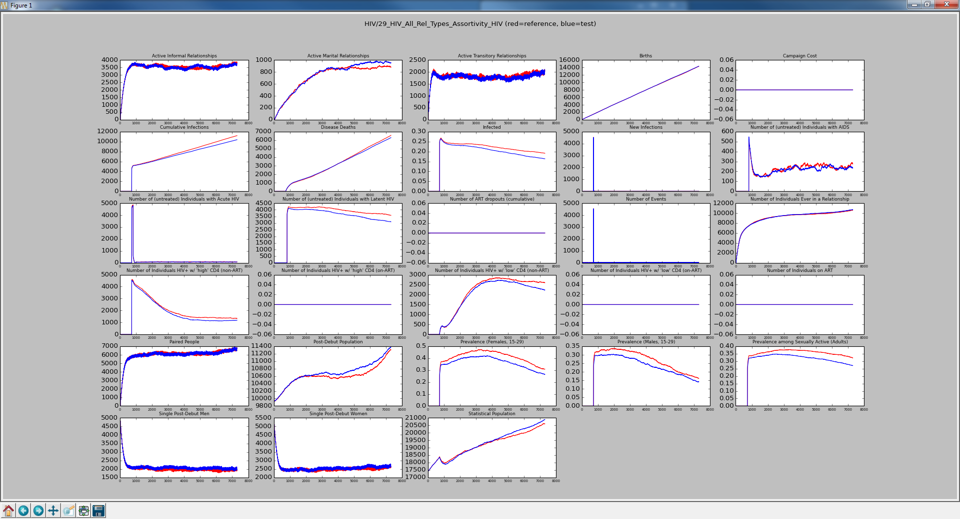
Red is All Types with No Groups Blue is All Types with Matrix
[0.6, 0.4],
[0.4, 0.6]
And more mixed = more infection

Slide 10
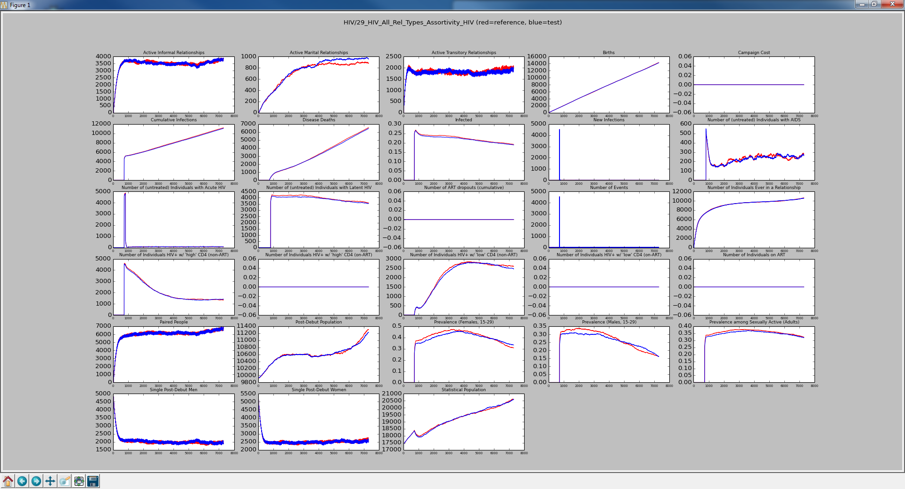
Red is All Types with No Groups Blue is All Types with Matrix
[0.5, 0.5],
[0.5, 0.5]
Back to the same as NO_GROUPS

Slide 11

Red is All Types with No Groups Blue is All Types with Matrix
[0.25, 0.75],
[0.75, 0.25]
Forcing more mixed relationships forces more infection, forcing more deaths.

Slide 12
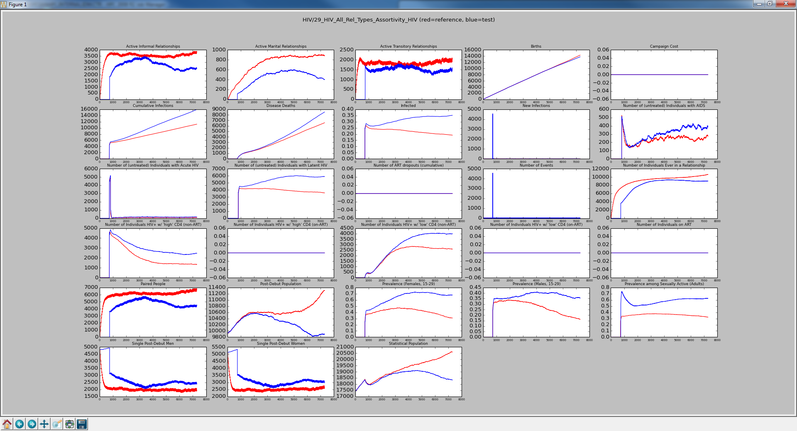
Red is All Types with No Groups Blue is All Types with Matrix
Forcing all relationships to be of mixed infection status causes the maximum spread of the disease. Notice that relationships are not created unless they are infected.
[0.0, 1.0],
[1.0, 0.0]

Slide 13
Test Update
Reduced Simulation_Duration from 7300 to 3000 to reduce runtime from > 5 minutes to less than 2.5 minutes.

Slide 14
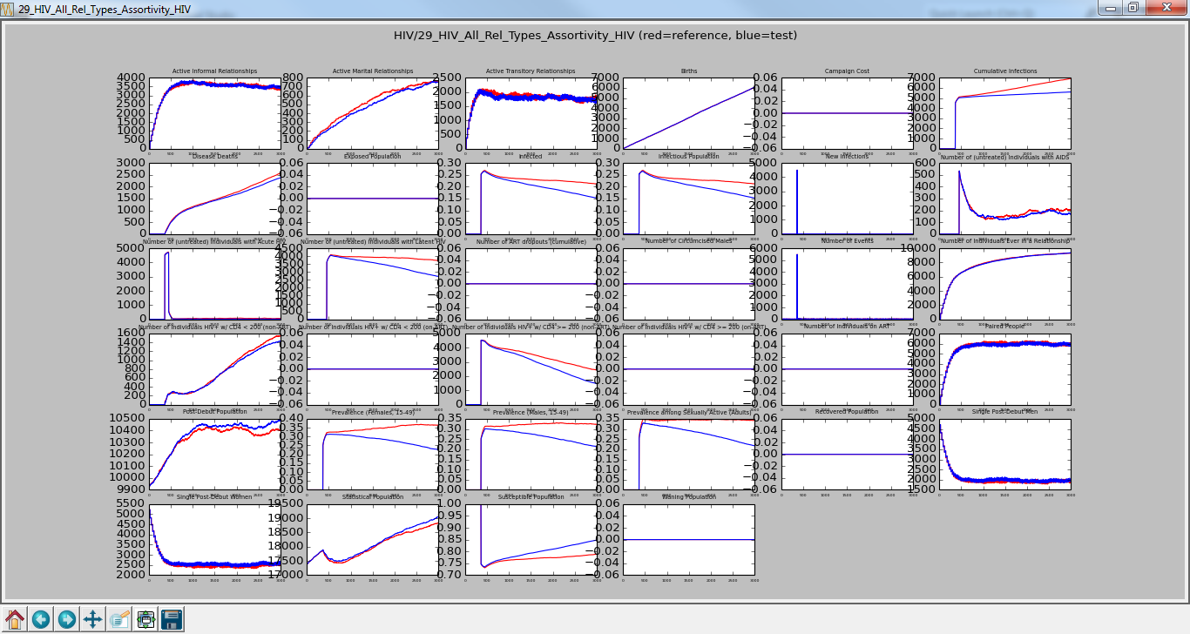
Red is All Types with No Groups Blue is All Types with Matrix
[1.0, 0.0],
[0.0, 1.0]
Simulation_Duration : 3000

Slide 15
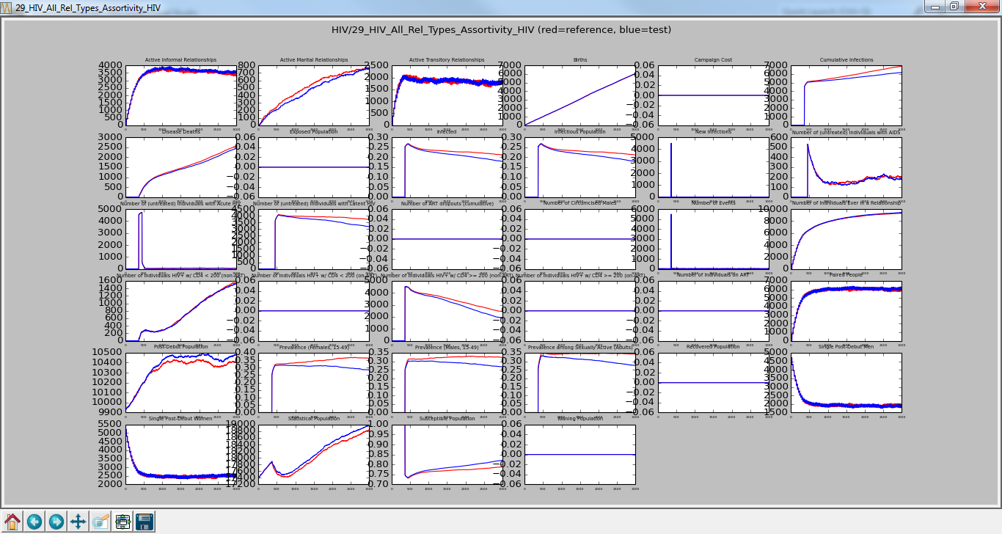
Red is All Types with No Groups Blue is All Types with Matrix
[0.9, 0.1],
[0.1, 0.9]
Simulation_Duration : 3000
Checked-In

